Slide 1

Conference of the Parties 15
Copenhagen, Denmark
December, 2009
American Association of Blacks in Energy

Slide 2
A Brief History
COP 1 Berlin 1995
COP 3 Kyoto 1997
  Binding Agreements
  Responsibilities of Developed Nations
  Use of the Most Relevant Technologies

Slide 3
History cont.
COP 6 The Hague 2000
  Clarifying Kyoto Implementation Mechanisms
  Defining Carbon Sinks
  Defining Sanctions
  Talks Collapse; Reconvene in April
  US Rejects Kyoto

Slide 4
History cont.
COP 10 Buenos Aires 2005
  Met without Substantive US Input. Kyoto Implementation Issues. “Post Kyoto” Discussions
COP 13 Bali 2007
  New Information-Climate Change is Unambiguous; Changing Faster than Anticipated;
  HARD (2 year) focus on COP 15

Slide 5
History cont.
COP 15 Copenhagen
  US Position- Binding Commitments
        Sanctions
        Verification
        Mitigation and Adaptation Are Needed

Slide 6
COP 15- Copenhagen
December 5 thru December 19
45,000 People from 192 Nations Attended
Difficult Logistics and Security
Demonstrations In and Out of the Bella Center
A very large multifaceted program of speakers and panels.
Programs Featuring US Speakers were dramatically oversubscribed.

Slide 7
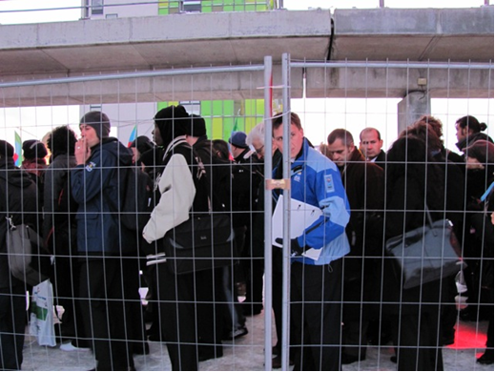
COP 15 – Copenhagen
Delegates waiting to get into Tuesday meetings

Slide 8
COP 15 - Copenhagen
Commission to Engage African American on Climate Change Chaired by Carolyn Green Staffed by Dr.Gina Wood and Dr.Michael Dorsey.
AABE materials part of the preparatory package and AABE participated in preparation meetings
Commission met with key US Officials including CEQ, NOAA, and EPA and key US NGO’s, including the Sierra Club and NRDC.
Three Press Interviews 2 US Press and 1 British Press

Slide 9
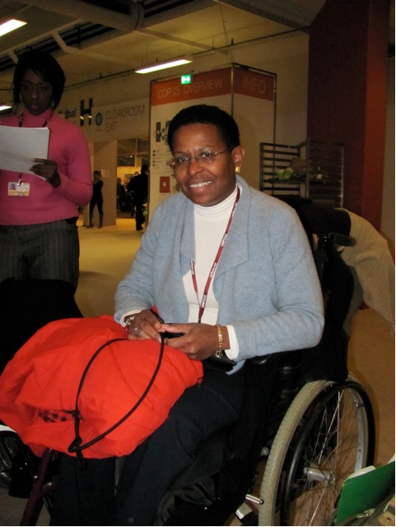
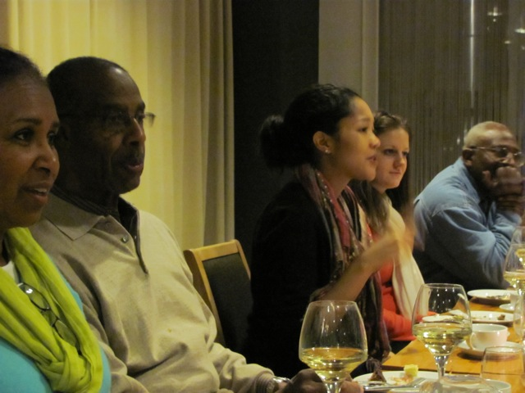
COP 15 - Copenhagen
Frank Stewart (2nd from left)
Carolyn Green
Joint Center for Economic and Political Studies, Commission to Engage African Americans in Climate Change sent a delegation led by AABE Chair, Carolyn Green, and included AABE President and COO, Frank Stewart

Slide 10
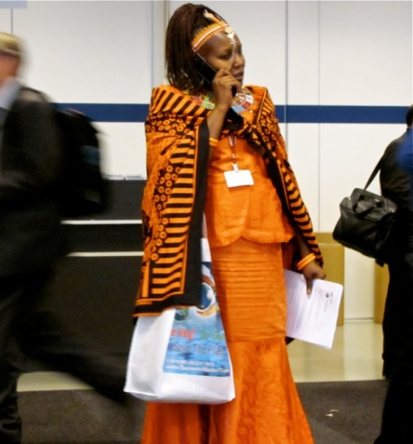
African Diaspora Issues
Not the Cause, But Asked to Bear the Responsibility
Already Feeling the Impact of Climate Change
Do Not have the Resources for Adaptation
Further Delay Exacerbates the Problem
Agreements Must Recognize Our Needs
    “One Africa One Degree”
Member of the Kenyan Delegation

Slide 11
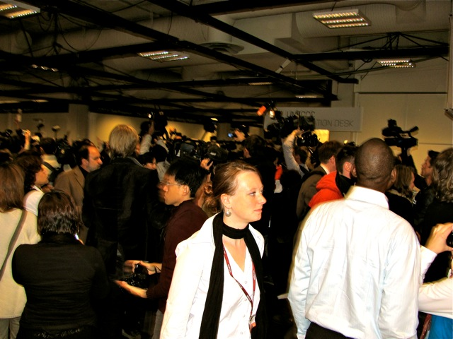
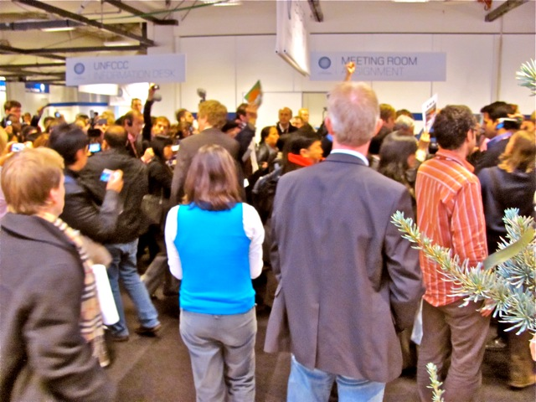
Indigenous People’s Walk-Out

Slide 12
COP 15- Copenhagen Accords
Reducing emissions to no more than 2 degrees Celsius above pre-industrial levels
Set a 50 percent by 2050 Objective
Redefined “Developing” and “Developed” Countries
Required Stated Commitments by February 2010
Required Sharing Information on Actions Taken
Non-binding agreement to make available $100 Billion annually to assist poorer Nations by 2020.
Established a New Body to Distribute the Funds
Agreed to by 28 of 192 nations

Slide 13
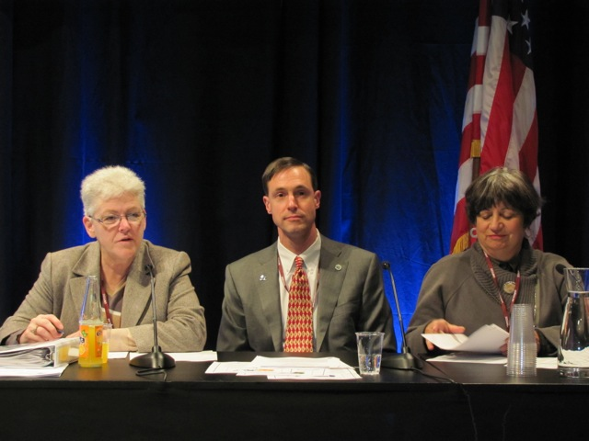
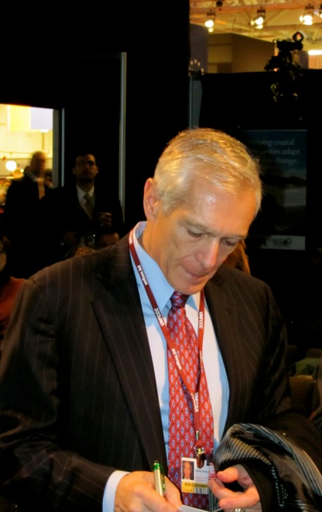
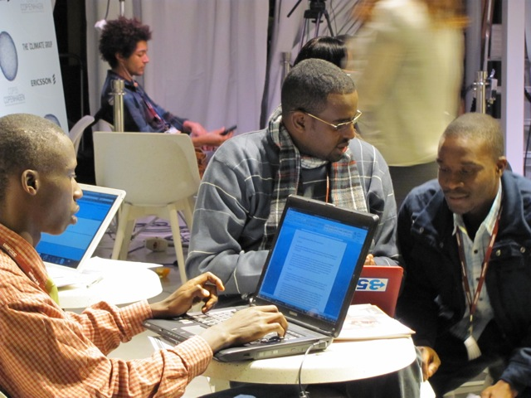
Copenhagen Participants
EPA Asst. Administrator for Air Gina McCarthy, Maine Air Commissioner David Lydell and Mary Nichols
Retired Gen. Wesley Clark
Left, African Youth Delegates

Slide 14
Copenhagen Outcomes
Generally Considered “Unsuccessful”, but set Groundwork for an Enforceable Agreement
An Atmosphere of Distrust and Suspicion
A Great Deal of Discussion about the Negotiation Process
President Sarkozy invited signers to meet in France in April to reopen the discussions.
President Evo Morales invited non-supporter nations to meet on April 22 in Bolivia.

Slide 15
Copenhagen Take-Aways
Role of African Americans needs to be Significantly Strengthened if We Are to Meet Both the Domestic and International Opportunities.
The Issues are very complex and involve:
  Preservation of species
  Human Health
  International Relations
  Environmental Justice
  Economic Justice

Slide 16
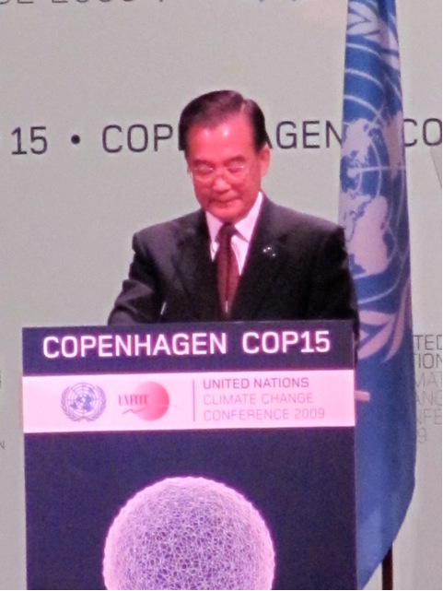
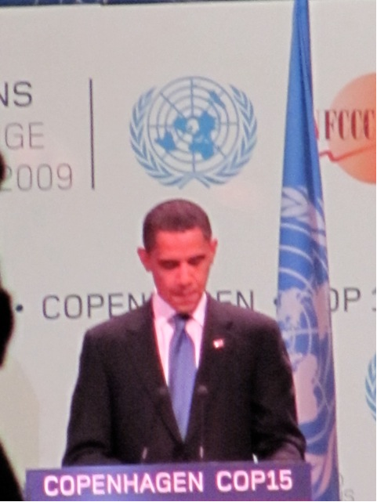
COP 15 - Copenhagen
UN Secretary General Ban Kee Moon
President Obama addressing the Convention

Slide 17
What’s New about COP15?
President Obama and the United States are Seriously Involved
Brazil, India, China were Significantly Involved
Industry and Government and Civil Society are All at the Table
Broad-Based Willingness to Get
Something Done
A Growing Sense that We are Running out of Time.
The Key Issues Are on the Table

Slide 18
What’s Next ?
A Year of Posturing, Plotting, and Planning.
Paris, France vs. La Paz, Bolivia in April
AABE National Conference May, 2010
US and World Politics are Very Dynamic
COP 16 Mexico City November, 2010
COP 17 Johannesburg November, 2011

